Slide 1
CYP PUBLIC HEALTH SERVICE 0 – 19 SCHOOL NURSING

Slide 2
OUR ROLE
School Nursing works across Education and Health, providing a link between the school, home and the community. Our aims are;
To promote the health and wellbeing of all children and young people
To work with families and young people from five to nineteen years of age
To work with one school or a group of schools depending on an identified need
To work together with other Health Services, Education, Social Care and Voluntary Agencies to give children and young people the support they need

Slide 3
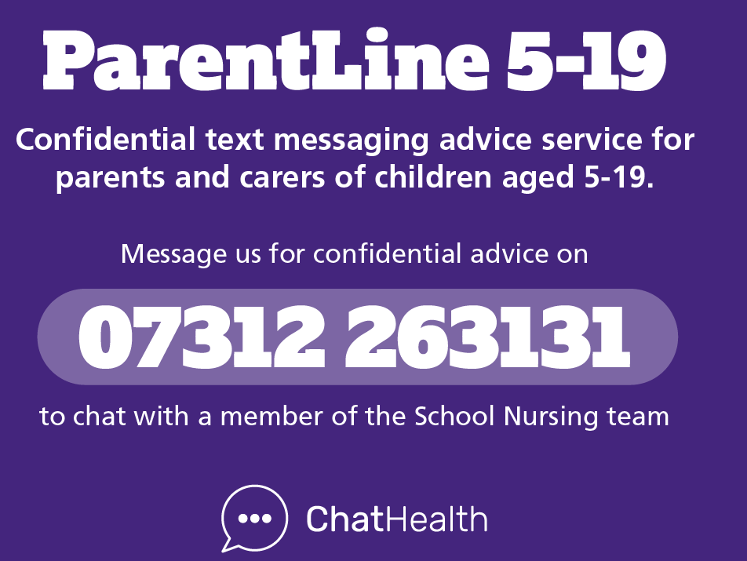
ACCESSING OUR SERVICE
We provide virtual clinics for children, from the age of 7, experiencing problems with Enuresis (night time wetting)
We are able to refer and signpost to other relevant services and Professionals
We use our Request for Support form which can be found on our webpage, to accept referrals for children and young people from other services, schools or parents
We have a texting service for parents/carers of school age children for advice and support

Slide 4
SCHOOL NURSING WEBPAGE
SEARCH FOR SCHOOL NURSING DORSET ON THE INTERNET FOR ALL THE CONTACT DETAILS AND RESOURCES YOU NEED or follow the below link
www.dorsethealthcare.nhs.uk/school-nursing

Slide 5
ADVICE AND SUPPORT VIA Request for Support
Our Request for Support Form aims to provide every parent/carer, school staff, GP or other services (with parental consent), the opportunity to discuss any aspect of a child’s health or well being with a member of the School Nursing Team, either via a virtual appointment, face to face or via telephone, where appropriate
School Nursing can support you with advice on the following:
Bed Wetting
Behaviour
Nutritional Advice
Sleep
Toileting
Emotional Wellbeing
General Health and wellbeing advice

Slide 6
School Health Nursery Nurses
School Health Nursery Nurses contact schools during the Autumn term to introduce themselves and talk about the upcoming years screening checks their Reception children will be offered –
National Child Measurement Programme (NCMP)
A video explaining the NCMP process can be viewed by parents/carers and children, the link below will also be sent in the NCMP notification letter sent to all parents/carers - https://vimeo.com/756835583/c959086cdb

Slide 7
NATIONAL CHILD MEASUREMENT PROGRAMME
Public Health England (now known as OHID) needs to have a good understanding of how healthy children are, so that the best possible health services and advice can be provided for the children, their families and school communities, where needed
As a result, a National Child Measurement Programme (NCMP) has been set up, to weigh and measure children, in England, in Reception and Year 6
Along with OHID the School Health Nursery Nurses will give feedback on how your child is developing and advice/support on changes you can make to keep them healthy

Slide 8
SCHOOL ENTRY HEALTH QUESTIONNAIRE
You will be sent a link to a digital Health Questionnaire via your child’s school, please complete and submit
You will be given the option to download or print a care plan for your child based on your responses along with resources, links and guidance
If you identify any areas of concern the School Nursing Team will be in touch about support or referrals that may be required

Slide 9
CONTACT NUMBER FOR THE SERVICE
Bournemouth, Christchurch, Poole and Dorset – 01929 557558

